Slide 1

The Florida Health Literacy Initiative: Helping English Language Learners to Make Healthy Choices
Greg Smith, Executive Director
Heather Surrency, Health & Financial Literacy Coordinator
Florida Literacy Coalition, Inc.
Smithg@floridaliteracy.org
Surrencyh@floridaliteracy.org
407-246-7110
www.floridaliteracy.org

Slide 2
Florida Literacy Coalition
Established in 1985, The Florida Literacy Coalition (FLC) promotes, supports and advocates for the effective delivery of quality adult and family literacy services in the state of Florida.
FLC provides a range of services to support more than 250 adult education, literacy and family literacy providers throughout Florida.

Slide 3
American Medical Association

Slide 4
The Health Literacy of America’s Adults
National Assessment of Adult Literacy
Definition: The degree to which individuals have the capacity to obtain, process, and understand basic health information and services needed to make appropriate health decisions.
Literacy Health Literacy
Below basic 14% 14%
Basic 29% 22%
Intermediate 44% 53%
Proficient 13% 12%

Slide 5
Forty nine percent of adults who did not complete high school have below basic health literacy.
Adults 65 and older have lower health literacy than younger age groups.
Hispanic adults have lower health literacy than people in any other ethnic/racial group, with 41% having below basic health literacy.

Slide 6
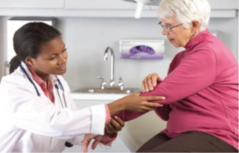
People with Poor Health Literacy
Are more likely to have a chronic disease
Less likely to get the health care they need
Have an average of three times as many prescriptions filled as adults with higher literacy
Are twice as likely to be hospitalized as those with higher literacy
Don’t live as long

Slide 7

Staying Healthy
An English Learner’s
Guide to Health Care and Healthy Living

Slide 8
Staying Healthy
Student resource book & teacher’s guide
> Hard copies distributed to 130+ programs
> Downloaded over 900,000 times
Evidence Based, written at the 5th grade level
For low-intermediate level ESOL learners and above
Simple, concrete, practical, with lots of images
Correlated to CASAS and Florida ESOL Course Standards
Funded by the Florida Department of Education

Slide 9
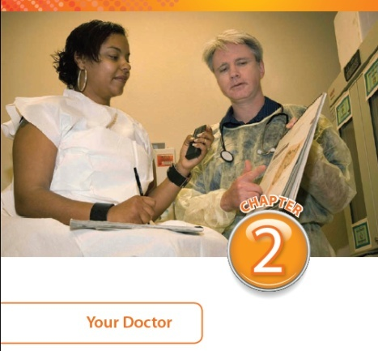
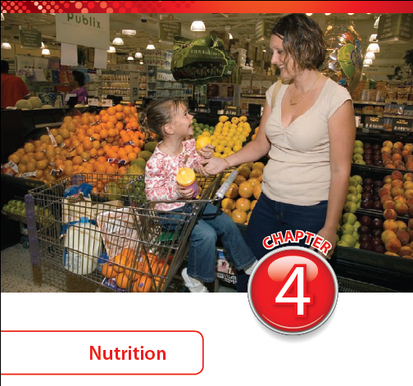
Chapter Topics
Chapter 1: Health Care
Chapter 2: Your Doctor
Chapter 3: Medicines
Chapter 4: Nutrition
Chapter 5: Chronic Diseases
Chapter 6: Staying Healthy

Slide 10

Women’s Health
  Topics covered include
  Menstruation
  Menopause
  Breast/female reproductive cancers
  Pregnancy
  Sexually Transmitted
  Infections
  Domestic abuse
  2010: Received the Reads Easy Award from Health Literacy Innovators

Slide 11

Coping with Stress
Topics covered include:
  Body’s reaction to stress
  Different types of stress
  Effects of stress on the body
  Ways to cope with stress
  Positive self-talk
  Importance of therapy

Slide 12

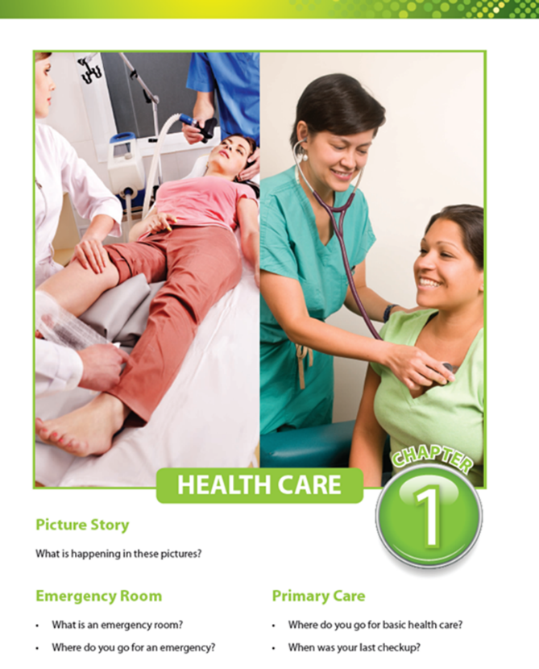
Staying Healthy
For Beginners
Download Free
www.floridaliteracy.org
Supported by: US Dept of Education, LINCS, Florida Dept of Education

Slide 13

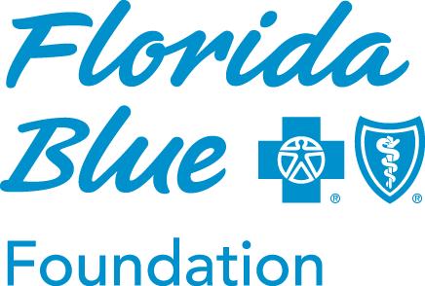
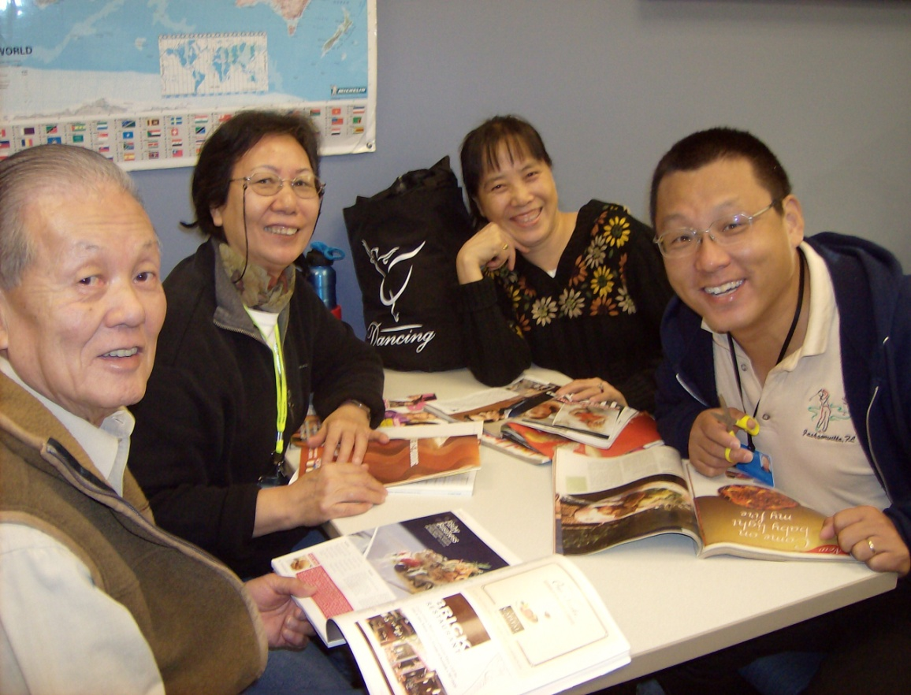
Florida Health Literacy Initiative
Recipient of the 2011 Award for Program Innovation and Collaboration
United States Conference on Adult Literacy

Slide 14
Results
7 years of grant support - $805,000
Grants of up to $5,000
15,000+ students and families served
Average improvement in HL assessment scores: 35%
Better prepared to address health concerns with doctor: 94%
Applied for at least one type of medical insurance
(Medicare, Marketplace, Medicaid, Florida KidCare, etc) 23%
Began exercising regularly: 41%
Changed their eating habits to be more healthful: 54%
Recommend program 96%

Slide 15
Partnerships are Key
Highlands County Soil and Water Conservation District office.
Hispanic Health Initiatives, Inc
Manatee Technical Institute’s nursing and dental departments
Mariner’s Hospital
Fl State College Nursing Program
Osceola County Extension Services
Osceola County Fire and Rescue
Pinellas Cooperative Extension Agency,
Poison Control Center-Tampa
South Florida Community College’s nursing and dental departments
University of Florida
Vision is Priceless-
Immokalee Fire Department
Pediatric Care Institution
All Faiths Food Bank
American Diabetes Association
American Lung Association
America’s Urgent Care
Center for Drug Free Living
Central Florida Sports & Physical Therapy
Community AIDS Network
East Lake Chiropractic
Fisherman’s Hospital
Florida Blood Centers
Florida Hospital
Hardee County Health Department
Mariner’s Hospital
Florida KidCare

Slide 16
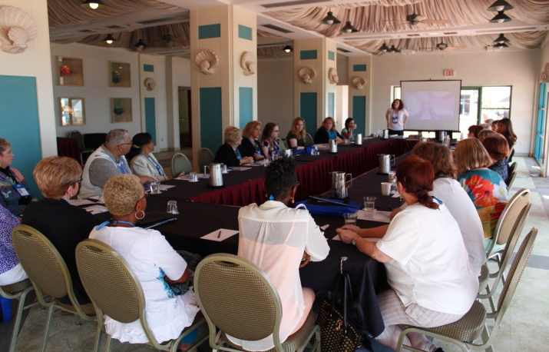
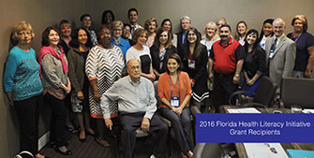
2016 Grant Recipients
Adult Literacy League
Community Health Centers of Sarasota County
DeSoto County Education Foundation
El Sol - Jupiter's Neighborhood Resource Center
Family Literacy Academy at Lake Wales
Flagler County New Beginnings Family Literacy
Lake Worth West Resident Planning Group
Learn to Read of St. Johns County
Literacy Council of Sarasota
Miami Dade College - Hialeah Campus
Miami Dade College - InterAmerican Campus
Parent Academy of St. Lucie County
Sarasota Family YMCA
United Food Bank of Plant City
William H. Turner Technical Arts Education Center

Slide 17
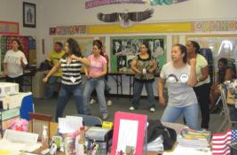
Field Trips and Classroom Visitors
Clinic and hospital guided tours
Presentations on ACA and Florida KidCare
UF/IFAS County extension services
Poison control
Doctors, nurses
Fire department
Exercise class
Grocery stores
Mock clinic at community health centers
Well water testing
Medical, nursing, dental schools

Slide 18
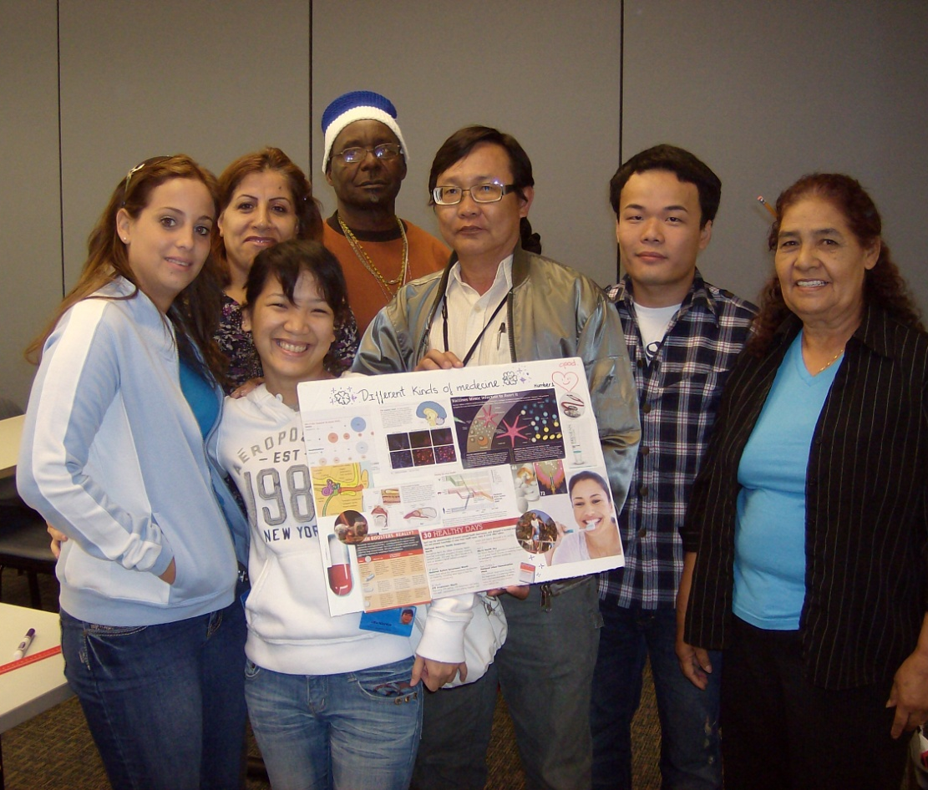
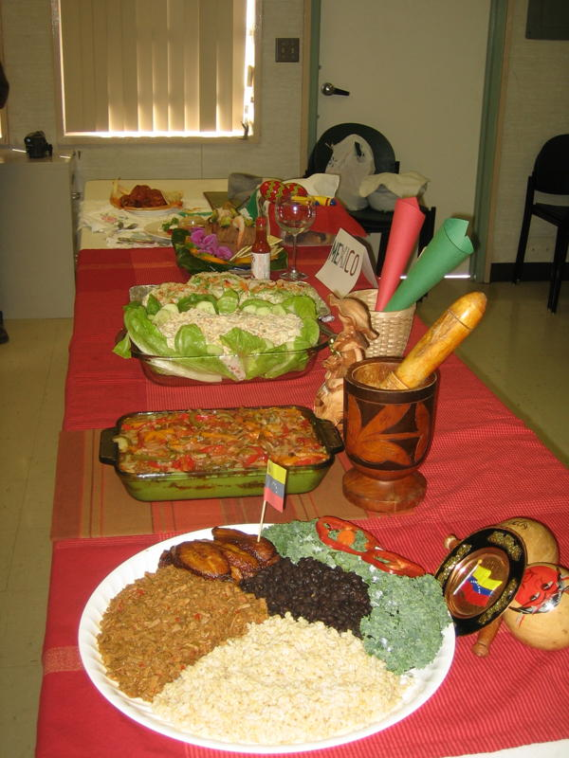
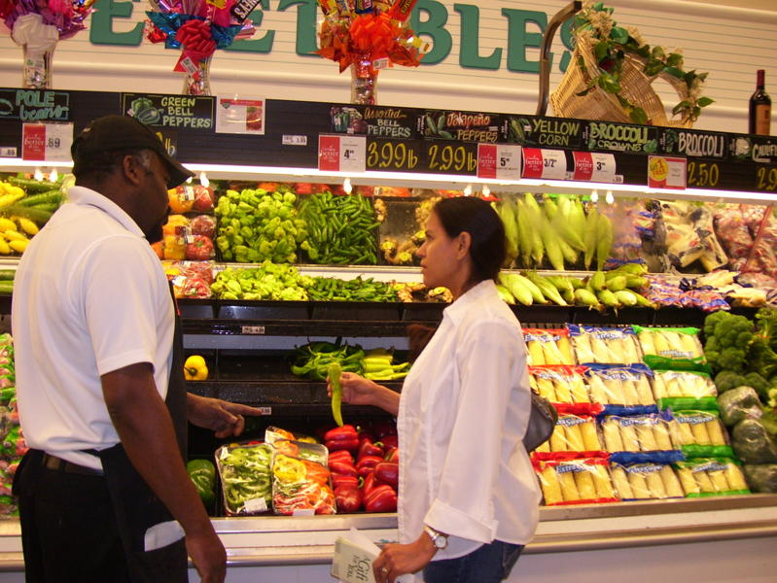
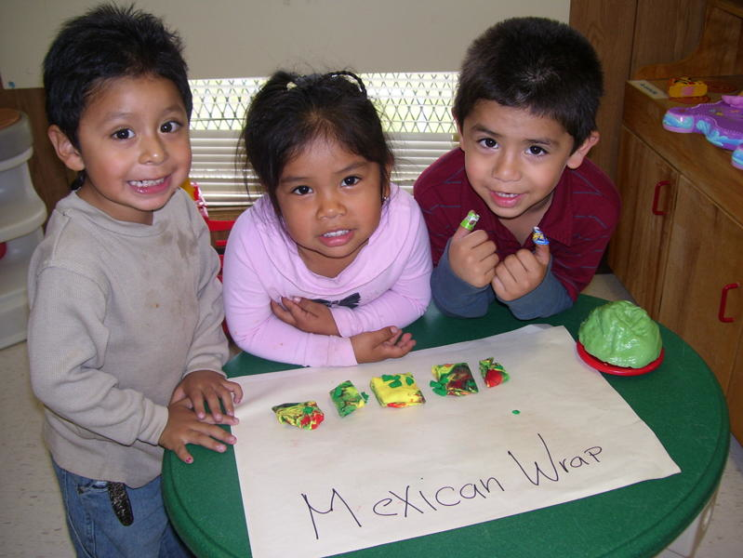
Project Based Learning
Doctor Song

Slide 19
Examples of Student Projects
Health fair, block party, or community bazaar
Organize and take Red Cross CPR Class
Publish “Now We Know: All About our Health” booklet
Partner with a children’s hospital and the fire dept. to educate about car seats and fire safety
Partner with Sheriff department to educate about pedestrian safety
Take a trip to the local vocational center to learn about health-related career programs
Sponsor a “Biggest Loser” nutrition and weight loss contest
Create videos on hand washing and reading medicine label
Partner with a local gym to offer free short-term memberships
Research project - Health Benefits of Red Wine and Grapes, and Preventing High blood Pressure
Organize a walk to raise funds for cancer research

Slide 20
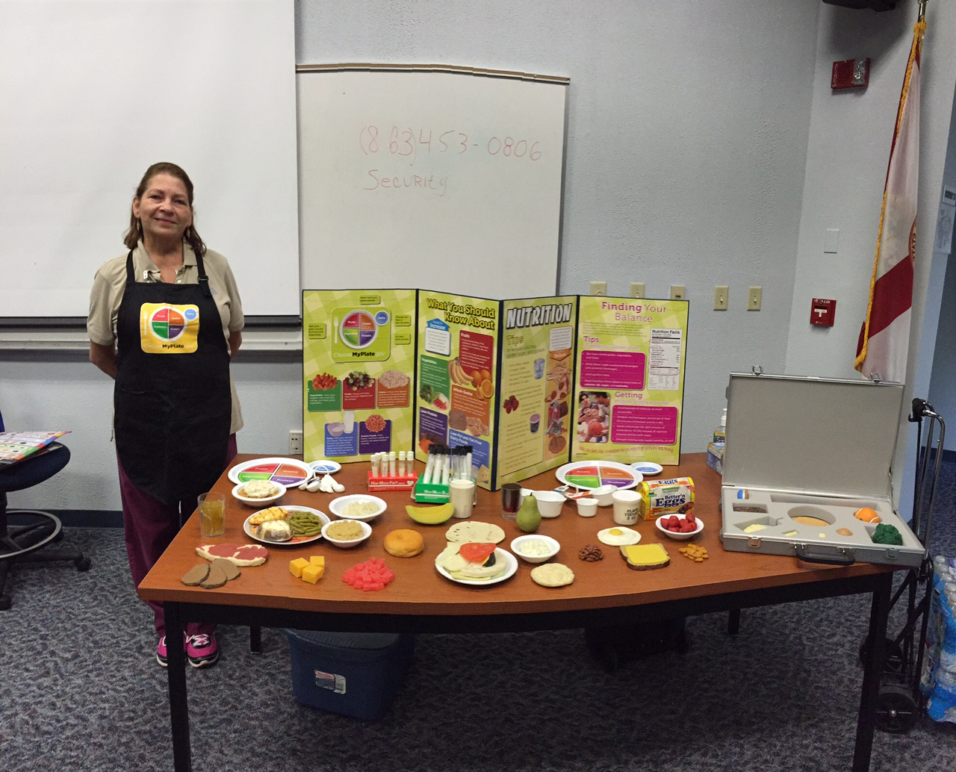
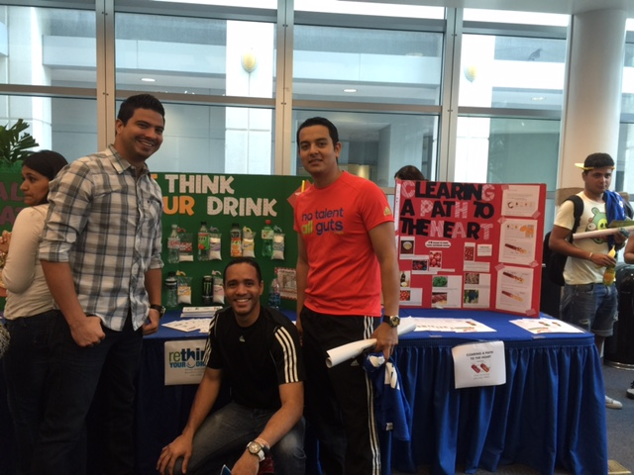
Examples of Student Projects
South Florida State College
Miami Dade College-InterAmerican

Slide 21
Resources
Florida Health Literacy Initiative www.floridaliteracy.org
MedlinePlus
www.medlineplus.gov
Ask Me 3 www.npsf.org/askme3
Health & Literacy Special Collection http://healthliteracy.worlded.org
Lessons for Living Well: Nutrition Education for Adult ESOL
www.lessonsforlivingwell.org
Health Literacy Wisconsin http://healthliteracywisconsin.org

